Slide 1
Data Communication and Computer Network
Unit 7

Slide 2
Communication
Communication is simply the act of transferring information from one place to another.

Slide 3

Data Communication
Data communication refers to the exchange of data between a source and a receiver through transmission media such as a wire or wireless.

Slide 4
Computer Network
It is an interconnection between two or more computer by using wire or wireless medium to share the hardware resources or software resources.

Slide 5
Importance of Computer Network:
Resource Sharing
Information Sharing
Communication medium
Centralized Control: All the computers and other components of a network are managed and controlled by a central computer which is known as server.
ecommerce
Back-up Support: Networked computers can be used to take back-up of important data.

Slide 6
Disadvantages of computer network:
It is expensive
Scarcity of skilled manpower of computer network.
Cyber crime may be originated
Computer virus spread easily through computer network.

Slide 7
Types of computer Network:
LAN
MAN
WAN

Slide 8
LAN(Local Area Network)
LAN, consists of a computer network at a single site, typically an individual office building. A LAN is very useful for sharing resources, such as data storage and printers.
The smallest LAN may only use two computers, while larger LANs can accommodate thousands of computers. A LAN typically relies mostly on wired connections for increased speed and security, but wireless connections can also be part of a LAN. High speed and relatively low cost are the defining characteristics of LANs.
LANs are typically used for single sites where people need to share resources among themselves but not with the rest of the outside world.

Slide 9
MAN(Metropolitan Area Network)
MAN, consists of a computer network across an entire city, campus or small region. A MAN is larger than a LAN, which is typically limited to a single building or site. Depending on the configuration, this type of network can cover an area from several miles to tens of miles. A MAN is often used to connect several LANs together to form a bigger network. When this type of network is specifically designed for a college campus, it is sometimes referred to as a campus area network, or CAN.

Slide 10
WAN(Wide Area Network)
WAN, occupies a very large area, such as an entire country or the entire world. A WAN can contain multiple smaller networks, such as LANs or MANs. The Internet is the best-known example of a public WAN.

Slide 11
Difference between LAN,MAN and WAN
BASIS OF COMPARISON | LAN | MAN | WAN
Meaning | A network that connects a group of computers in a small geographical area. | MAN, consists of a computer network across an entire city, campus. | WAN, occupies a very large area, such as an entire country or the entire world.
Ownership of Network | Private | Private or Public | Private or Public
Design and maintenance | Easy | Difficult | Difficult
Propagation Delay | Short | Moderate | Long
Speed | High | Moderate | Low
Fault Tolerance | More Tolerant | Less Tolerant | Less Tolerant
Congestion | Less | More | More

Slide 12
Network Architecture:
Network architecture refers to how computers are organized in a system and how tasks are allocated between these computers.
Two of the most widely used types of network architecture are
peer-to-peer Architecture
client/server Architecture

Slide 13
Peer-to-Peer Architecture
In a peer-to-peer or P2P network, the tasks are allocated among all the members of the network. There is no real hierarchy among the computers, and all of them are considered equal. This is also referred as workgroup without hierarchy. A peer-to-peer network does not use a central computer server that controls network activity. Instead, every computer on the network has a special software running that allows for communications between all the computers.

Slide 14
Advantages of Peer-to-Peer Architecture
It is easy to install
All the resources and contents are shared by all the peers
P2P is more reliable as central dependency is eliminated. Failure of one peer doesn’t affect the functioning of other peers.
There is no need for full-time System Administrator. Every user is the administrator of his machine. User can control their shared resources.
The over-all cost of building and maintaining this type of network is comparatively very less.

Slide 15
Disadvantages of Peer-to-Peer Architecture
Network Security applies only to a single resource at a time.
Data recovery or backup is very difficult. Each computer should have its own back-up system
No control of access to data as there is no server.

Slide 16
client/server Architecture
In client/server model, all the client computers are connected to the server computer. Server will provide different service like file service, print service, database service, message service etc. A client computer requests service to server and the server will give that service to client. Server is responsible to control, manage and provide service to the client.

Slide 17
Advantages of client/server Architecture
Centralization : It provides centralized control. Servers help in administering the whole set-up. Access rights and resource allocation is done by Servers.
Proper Management : All the files are stored at the same place. In this way, management of files becomes easy. Also it becomes easier to find files.
Back-up and Recovery possible : As all the data is stored on server its easy to make a back-up of it. Also, in case of some break-down if data is lost, it can be recovered easily and efficiently.
Upgradation and Scalability : Changes can be made easily by just upgrading the server. Also new resources and systems can be added by making necessary changes in server.
Accessibility : From various platforms in the network, server can be accessed remotely.
As new information is uploaded in database , each workstation need not have its own storage capacities increased . All the changes are made only in central computer on which server database exists.
Security : Rules defining security and access rights can be defined at the time of set-up of server.

Slide 18
Disadvantages of Client Server Architecture
Congestion in Network :Too many requests from the clients may lead to congestion. Overload can lead to breaking-down of servers.
If the server fails, the whole network goes down.
Cost : It is very expensive to install and manage this type of computing.
You need professional IT people to maintain the servers and other technical details of network.

Slide 19
Data Transmission
Data transmission refers to the process of sending digital or analog data from one point to another through a communication medium. This is the foundation of modern communication systems, including the internet, telephony, and local networking.

Slide 20
Transmission media:
The media through which data transmits from one computer to another computer is called transmission media.
Type of Transmission media: 1) Guided Media.
2) Unguided Media.

Slide 21
Guided Media
Those media which uses cables or wires to transmit data from one device to another is called guided media. It is also called bounded media.
E.g. are Twisted Pair, Coaxial cable, Optical Fiber cable.

Slide 22
Unguided Media
Those media which transmit data through air from one device to another is called unguided media. It is also called unbounded media.
E.g. are Microwave Transmission, Satellite Transmission etc.

Slide 23
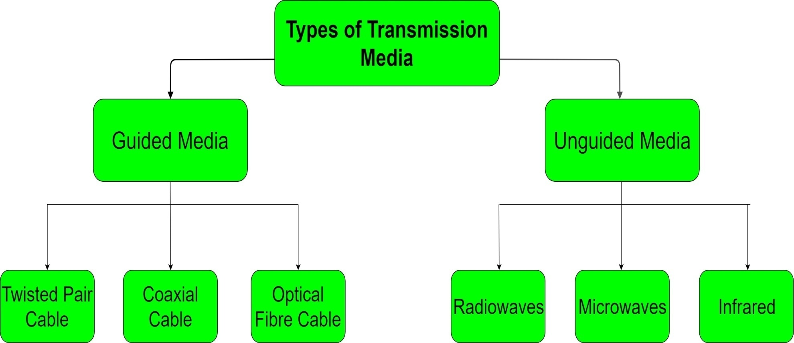
Types of Transmission Media

Slide 24
Guided Media: (1) Twisted Pair Cable
It consists of two identical wires wrapped together in double helix. Twisting of wires reduces crosstalk and also prevents from external interference. Twisted Pair is of two types:
Unshielded Twisted Pair (UTP)
Shielded Twisted Pair (STP):
Advantages:
It is simple
Easy to install
Flexible
Low weight
cheaper
Disadvantages:
Attenuation (loss of signal) when used for long distance.
Low bandwidth.
Data transmission rate is less.

Slide 25
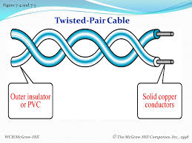
Fig of twisted pair cable

Slide 26
2) Coaxial Cable
It consists of inner conductor and it is surrounded by insulator. After insulator there is wire mesh conductor. All is covered by outer insulator. It is widely used in cable television.
Advantages:
High Bandwidth
Used for Broadband transmission.
It has less Attenuation than twisted pair cable.
Data transmission rate is higher than twisted pair cable.
Disadvantages:
expensive compare to twisted pair cable.
the thicker the cable, the more difficult to work with.

Slide 27
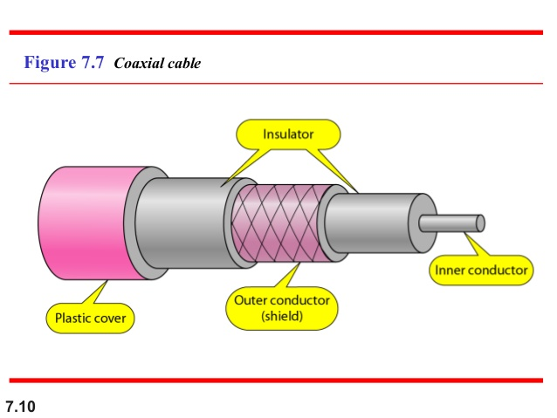

Slide 28
3) Optical Fiber Cable
It consists of an inner glass core surrounded by glass like material called cladding. It also has protective coating. All is covered by outer insulator. It works on the concept of total internal reflection. It is used for transmission of large volumes of data.
Advantages:
It provides more bandwidth
High data transmission rate.
Less signal attenuation
It is immunity to electromagnetic interference
It provides Secure transmission.
It is used for Broadband transmission.
Disadvantages:
Difficult to install and maintain
It is expensive.
Fragile

Slide 29
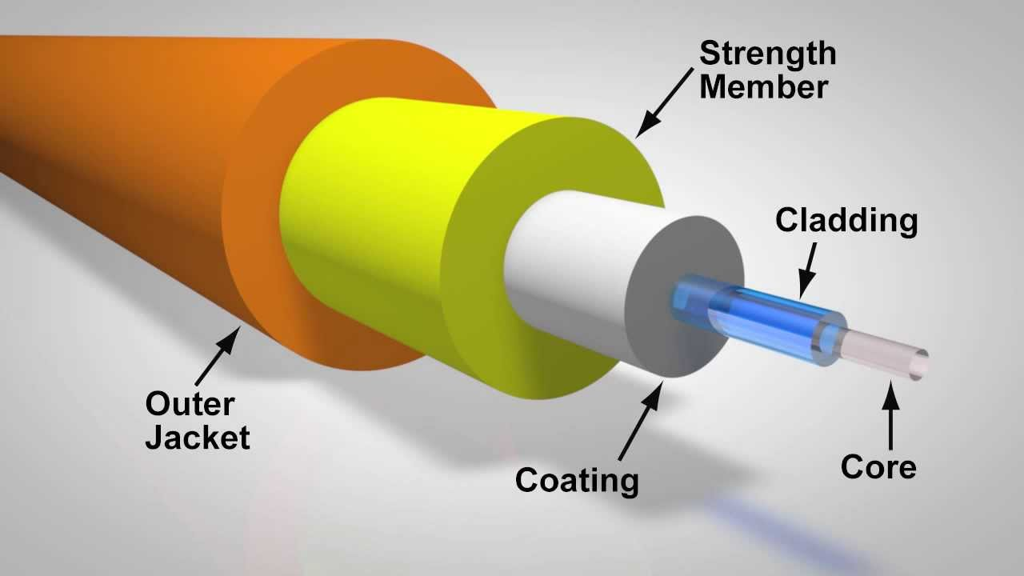
Fig of fiber optic cable

Slide 30
Unguided Media:
Radiowaves – These are easy to generate and can penetrate through buildings. The sending and receiving antennas need not be aligned. Frequency Range:3KHz – 1GHz. AM and FM radios and cordless phones use Radiowaves for transmission.
Microwaves – It is a line of sight transmission i.e. the sending and receiving antennas need to be properly aligned with each other. The distance covered by the signal is directly proportional to the height of the antenna. Frequency Range:1GHz – 300GHz. These are majorly used for mobile phone communication.
Satellite- Satellites are set in geo-stationary orbits, which rotates in synchronization to earth and hence look stationary from any point on the earth. Geo-stationary orbits are 36000 km above the earth’s surface. The communication is carried through uplinks and downlinks. The uplink transmits the data to the satellite and downlink receives the data from the satellite. Uplinks and downlinks are also called earth stations because they are located on the earth. It is visible from any part of the earth. E.g. Google earth, Google maps are using satellite communication.
(iv) Infrared – Infrared waves are used for very short distance communication. They cannot penetrate through obstacles. This prevents interference between systems. Frequency Range:300GHz – 400THz. It is used in TV remotes, wireless mouse, keyboard, printer, etc.

Slide 31
Transmission Modes:
Transmission mode refers to the mechanism of transferring of data between two devices connected over a network. It is also called Communication Mode. These modes direct the direction of flow of information.
The different transmission modes are
Simplex
Half Duplex
Full Duplex

Slide 32
SIMPLEX Mode
In this type of transmission mode, data can be sent only in one direction i.e. communication is unidirectional. We cannot send a message back to the sender. Unidirectional communication is done in Simplex Systems where we just need to send a command/signal, and do not expect any response back.
Examples of simplex Mode are Radio, television etc.

Slide 33
HALF DUPLEX Mode
Half-duplex data transmission means that data can be transmitted in both directions, but not at the same time.
Half-duplex transmission implies a bidirectional line but data can be sent in only one direction at a time.
Example of half duplex is a walkie- talkie

Slide 34
FULL DUPLEX Mode
In full duplex system data can be sent in both directions simultaneously.
Full-duplex transmission implies a bidirectional line
Example of Full Duplex is a Telephone Network, internet etc.

Slide 35
Bandwidth:
It is the amount of data that can be transferred in a communication media in a fixed period of time. It is measured in Hertz(Hz).

Slide 36
Difference between Analog signal and Digital signal
Analog signal
An analog signal is a continuous wave that changes over a time period.
Analog signal has no fixed range.
An analog signal is more prone to distortion.
An analog signal is described by the amplitude, frequency, and phase.
An analog signal is represented by a sine wave.
The human voice is the best example of an analog signal.
Digital signal
A digital signal is a discrete wave that carries information in binary form.
Digital signal has a finite range i.e. between 0 and 1.
A digital signal is less prone to distortion.
A digital signal is described by bit rate and bit intervals.
A digital signal is represented by square waves.
Signals used for transmission in a computer are the digital signal.

Slide 37
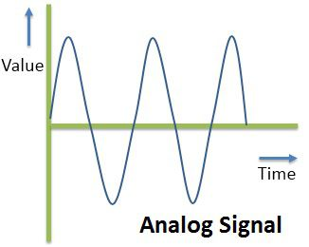
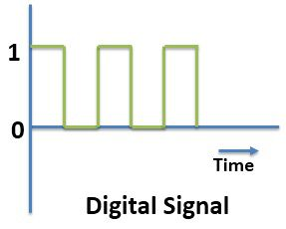
Fig analog and digital signal

Slide 38
A network topology(LAN Topology)
A network topology is the arrangement of a network, including its nodes and connecting lines.
Types of network topology are :
Bus Topology
Ring Topology
Star Topology

Slide 39
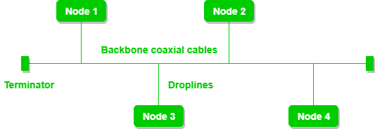
Bus Topology
Bus topology is the simplest of the network topology in which every computer is connected to single cable called bus.

Slide 40
Advantages of Bus Topology
It is easy to set-up and extend.
Cable length required is least compared to other network topology.
Bus topology is comparatively cheaper.
We can easily add or remove computer.
Problem in one computer doesnot disturb other computer.
Disadvantages of Bus Topology
If the main cable fails then whole network fails.
There is maximum chance of collision of data.
Troubleshooting is difficult.

Slide 41
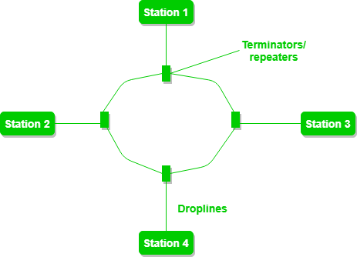
Ring topology
It is called ring topology because it forms a ring as each computer is connected to another computer, with the last one connected to the first. Exactly two neighbors for each device.

Slide 42
Advantages of Ring topology:
It helps to reduce the chances of data collision.
There is no need for server.
Each computer has equal access to use the resource.
Disadvantages of Ring topology:
If problem occurs in one computer, then whole network goes down.
It is difficult to add or remove computer in ring topology.
Troubleshooting is difficult in this topology.

Slide 43
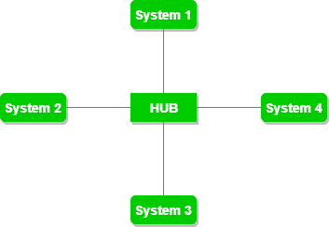
Star Topology:
In this topology, all the components of network are connected to the central device called hub or switch. All the data on the star topology passes through the hub before reaching to the intended destination.

Slide 44
Advantages:
We can easily add or remove computer from the network
If problem occurs in one computer then other computer can continue their work.
Trouble shooting is easy.
Disadvantages:
If problem occurs in hub then whole network goes down.
Cost of installation is high.
Performance is based on the central device called hub.

Slide 45
Mesh Topology:
It is a point-to-point connection to other nodes . All the network nodes are connected to each other.

Slide 46
Advantages :
It is robust.
It is reliable. Data can never fail to be delivered, if one connection goes down, there are other ways to route the data to its destination.
Provides security and privacy.
Disadvantages :
Installation and configuration is difficult.
Cost of cables are high as bulk wiring is required, hence suitable for less number of devices.
Cost of maintenance is high.

Slide 47
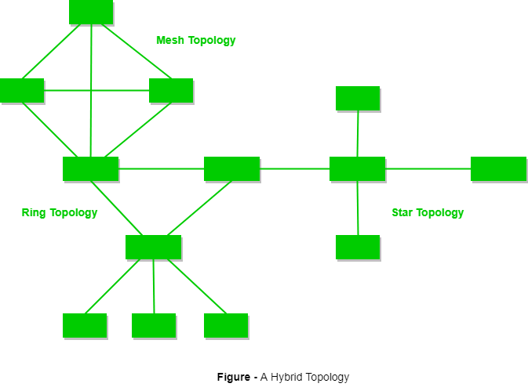
Hybrid Topology :
​This topology is a collection of two or more topologies which are described above. This is a scalable topology which can be expanded easily. It is reliable one but at the same it is a costly topology.

Slide 48
Network Devices:
The devices having two or more ports to which the computers and other devices can be connected are called network devices. It also amplifies the signal to restore the original strength of the signal.
E.g. Network Interface card, Repeater, Hub, switch, bridge, gateway etc.

Slide 49
Network Interface card
A network interface card is a computer hardware component that connects a computer to a computer network.
The term network interface card is often considered interchangeable with the terms network interface controller, network adapter and LAN adapter.

Slide 50
Repeater:
Repeater is a device which regenerate the signal so that the signal is as strong as the original signal. They can extend the reach of network.

Slide 51
bridge
A bridge is a device with add on functionality of filtering content by reading the MAC addresses of source and destination. A bridge operates at the data link layer of the OSI reference model. It is also used for interconnecting two LANs working on the same protocol. It has a single input and single output port, thus making it a 2 port device.

Slide 52
Hub:
A hub is a common connection point for devices in a network. Hubs are devices commonly used to connect computers of a LAN in star topology. The hub contains multiple ports. A hub is basically called a multiport repeater. Hub works at the Physical Layer of OSI reference model. When a packet arrives at one port, it is copied to the other ports so that all computers of the LAN can see all packets.

Slide 53
switch
A switch is a device with a buffer and a design that can boost its efficiency and performance. Switches work at the Data Link Layer of the OSI(Open System Interconnection) reference model. Switch can perform error checking before forwarding data, that makes it very efficient as it does not forward packets that have errors and forward good packets selectively to correct port only.

Slide 54
Routers
A router is a device that routes data packets based on their IP addresses. Routers work at the Network Layer of the OSI(Open System Interconnection) reference model. Routers normally connect LANs and WANs together and have a dynamically updating routing table based on which they make decisions on routing the data packets.

Slide 55
Gateway
A gateway, as the name suggests, is a passage to connect two networks together that may work upon different networking models. They basically works as the messenger agents that take data from one system, interpret it, and transfer it to another system. Gateways are also called protocol converters and gateway operates at the network layer of the OSI Model. Gateways are generally more complex than switch or router.

Slide 56
Communication protocol
A network protocol defines rules and conventions for communication between network devices.
E.g TCP/IP, FTP etc.

Slide 57
OSI model:
OSI (Open Systems Interconnection) is a reference model for how applications communicate over a network.
A reference model is a conceptual framework for understanding relationships. The purpose of the OSI reference model is to guide vendors and developers so the digital communication products and software programs they create can interoperate, and to facilitate a clear framework that describes the functions of a networking or telecommunication system.
The OSI architecture was officially adopted as an international standard by the International Organization for Standardization (ISO).
OSI model is divided into seven layers.

Slide 58
OSI layers:
Layer 7: The application layer
Layer 6: The presentation layer
Layer 5: The session layer
Layer 4: The transport layer
Layer 3: The network layer
Layer 2: The data-link layer
Layer 1: The physical layer

Slide 59
Layer 7 - Application
An application layer serves as a window for users and application processes to access network service.
This layer provides the network services to the end-users.
Functions of Application layer:
File transfer, access, and management (FTAM)
Mail services: An application layer provides the facility for email forwarding and storage.
Directory services: An application provides the distributed database sources and is used to provide that global information about various objects.

Slide 60
Layer 6 - Presentation
A Presentation layer is mainly concerned with the syntax and semantics of the information exchanged between the two systems.
It acts as a data translator for a network.
This layer converts the data from one presentation format to another format.
Functions of Presentation layer:
Translation
Encryption: Encryption is needed to maintain privacy. Encryption is a process of converting the sender-transmitted information into another form and sends the resulting message over the network.
Compression: Data compression is a process of compressing the data, i.e., it reduces the number of bits to be transmitted. Data compression is very important in multimedia such as text, audio, video.

Slide 61
Layer 5 - Session
The Session layer is used to establish, maintain and synchronizes the interaction between communicating devices.
Functions of Session layer:
Dialog control: Session layer acts as a dialog controller that creates a dialog between two processes or we can say that it allows the communication between two processes which can be either half-duplex or full-duplex.
Synchronization: Session layer adds some checkpoints when transmitting the data in a sequence. If some error occurs in the middle of the transmission of data, then the transmission will take place again from the checkpoint. This process is known as Synchronization and recovery.

Slide 62
Layer 4 – Transport
The Transport layer ensures that messages are transmitted in the order in which they are sent and there is no duplication of data.
It receives the data from the upper layer and converts them into smaller units known as segments.
This layer can be termed as an end-to-end layer as it provides a point-to-point connection between source and destination to deliver the data reliably.
The two protocols used in this layer areTransmission Control Protocol(TCP) and User Datagram Protocol (UDP)
Functions of Transport Layer:
Segmentation and reassembly.
Connection control.
Flow control.
Error control.

Slide 63
Layer 3 - Network
This layer determines the best path to move data from source to the destination based on the network conditions, the priority of service, and other factors.
The Network layer is responsible for routing and forwarding the packets.
The protocols used to route the network traffic are known as Network layer protocols. Examples of protocols are IP and Ipv6.
Functions of Network Layer:
Addressing: A Network layer adds the source and destination address to the header of the frame. Addressing is used to identify the device on the internet.
Routing: Routing is the major component of the network layer, and it determines the best optimal path out of the multiple paths from source to the destination.
Packetizing: A Network Layer receives the segments of data from the upper layer and converts them into packets. This process is known as Packetizing. It is achieved by internet protocol (IP).

Slide 64
Layer 2 – Data Link
This layer is responsible for the error-free transfer of data frames.
It contains two sub-layers:
Logical Link Control Layer
Media Access Control Layer
Functions of the Data-link layer
Framing.
Physical Addressing
Flow Control
Error Control
Access Control

Slide 65
Layer 1 - Physical
The main functionality of the physical layer is to transmit the individual bits from one node to another node.
It is the lowest layer of the OSI model.
It establishes, maintains and deactivates the physical connection.
Functions of a Physical layer:
It defines the transmission media used, i.e guided or unguided media
It defines the transmission mode whether it is simplex, half-duplex or full-duplex mode between the two devices on the network.
It defines the network topology .
It defines the data transmission rate.
It defines the synchronization of bits.

Slide 66
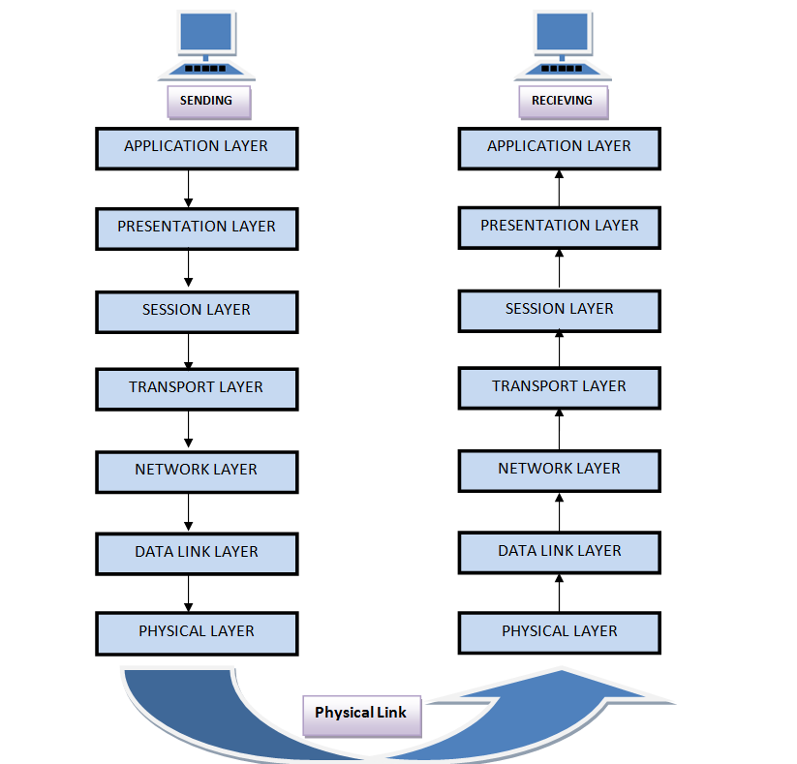
Fig OSI model

Slide 67
TCP/IP model:
It is based on standard protocols. It stands for Transmission Control Protocol/Internet Protocol. The TCP/IP model is a short version of the OSI model. It contains four layers, unlike seven layers in the OSI model. The layers are:
Application Layer
Transport Layer
Internet Layer
Network Access Layer

Slide 68
Layer 4 - Application Layer
An application layer is the topmost layer in the TCP/IP model.
This layer allows the user to interact with the application.
When one application layer protocol wants to communicate with another application layer, it forwards its data to the transport layer.
There is an ambiguity occurs in the application layer. Every application cannot be placed inside the application layer except those who interact with the communication system. For example: text editor cannot be considered in application layer while web browser using HTTP protocol interact with the network.
Protocols used in the application layer are HTTP,SMTP,FTP

Slide 69
3) Transport Layer
The transport layer is responsible for the reliability, flow control, and correction of data which is being sent over the network.
The two protocols used in the transport layer are User Datagram protocol(UDP) and Transmission control protocol(TCP).

Slide 70
2) Internet Layer
An internet layer is also known as the network layer.
The internet layer is responsible for addressing, routing, and packaging data packets called IP datagrams.
The Internet Protocol(IP) is one of the protocols used in this layer.

Slide 71
1) Network Access Layer
A network layer is the lowest layer of the TCP/IP model.
A network layer is the combination of the Physical layer and Data Link layer defined in the OSI reference model.
The network layer is responsible for placing packets on and receiving them from the network medium.
The protocols used by this layer are Ethernet, token ring, FDDI(Fiber Distributed Data Interface).

Slide 72
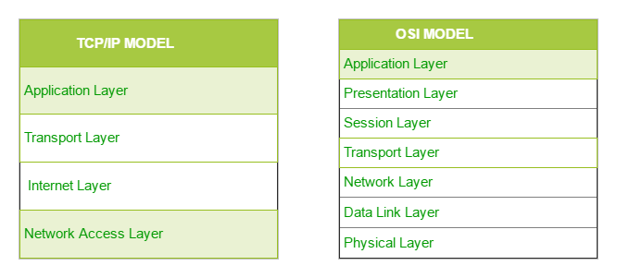
Fig TCP/IP model and OSI Model

Slide 73
Difference between TCP/IP and OSI Reference Model
TCP/IP | OSI Reference Model
It is a client server model used for transmission of data over the internet. | 1. It is a theoretical model which is used for computing system.
2. It consists of 4 Layers | 2. It consists of 7 Layers
3. It is developed by Department of Defense (DoD) | 3. It is developed by ISO (International Standard Organization)
4. It combines the session and presentation layer in the application layer. | 4. It has separate session and presentation layer
5. TCP/IP developed protocols then model. | 5. OSI developed model then protocol.
6. TCP/IP is more reliable | 6. OSI is less reliable

Slide 74
Data transmission and Data Networking:
For Long distance communication, a network of nodes is used as a communication medium.
Switching technique is used in data transmission and data networking

Slide 75
Switching
When a user accesses the internet or another computer network outside their immediate location, messages are sent through the network of transmission media. This technique of transferring the information from one computer network to another network is known as switching.

Slide 76
Circuit Switching
Circuit switching is a switching technique that establishes a dedicated path between sender and receiver.
In the Circuit Switching Technique, once the connection is established then the dedicated path will remain to exist until the connection is terminated.
Circuit switching in a network operates in a similar way as the telephone works.
A complete end-to-end path must exist before the communication takes place.
In case of circuit switching technique, when any user wants to send the data, request signal is sent to the receiver then the receiver sends back the acknowledgment to ensure the availability of the dedicated path. After receiving the acknowledgment, dedicated path transfers the data.
Fixed data can be transferred at a time in circuit switching technology.

Slide 77
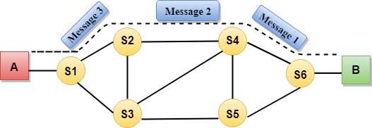
Fig circuit switching

Slide 78
Message Switching
Message Switching is a switching technique in which a message is transferred as a complete unit and routed through intermediate nodes at which it is stored and forwarded.
In Message Switching technique, there is no establishment of a dedicated path between the sender and receiver.
Message switches are programmed in such a way so that they can provide the most efficient routes.
Each and every node stores the entire message and then forward it to the next node. This type of network is known as store and forward network.
Telegraph uses message switching.

Slide 79
Advantages Of Message Switching
Data channels are shared among the communicating devices that improve the efficiency of using available bandwidth.
Traffic congestion can be reduced because the message is temporarily stored in the nodes.
The size of the message which is sent over the network can be varied. Therefore, it supports the data of unlimited size.
Disadvantages Of Message Switching
The message switches must be equipped with sufficient storage to enable them to store the messages until the message is forwarded.
The Long delay can occur due to the storing and forwarding facility provided by the message switching technique.

Slide 80
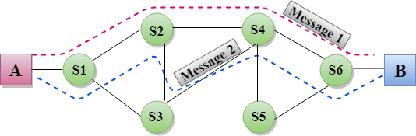
Fig of message switching

Slide 81
Packet Switching
The packet switching is a switching technique in which message is divided into smaller pieces, and they are sent individually.
The message splits into smaller pieces known as packets and packets are given a unique number to identify their order at the receiving end.
Every packet contains some information in its headers such as source address, destination address and sequence number.
Packets will travel across the network, taking the shortest path as possible.
All the packets are reassembled at the receiving end in correct order.
If any packet is missing or corrupted, then the message will be resend .
If the correct order of the packets is reached, then the acknowledgment message will be sent.
Internet uses packet switching.

Slide 82
Advantages Of Packet Switching:
Cost-effective: In packet switching technique, switching devices do not require massive storage to store the packets, so cost is minimized to some extent. Therefore, we can say that the packet switching technique is a cost-effective technique.
Reliable: If any node is busy, then the packets can be rerouted. This ensures that the Packet Switching technique provides reliable communication.
Efficient: Packet Switching is an efficient technique. It does not require any established path prior to the transmission, and many users can use the same communication channel simultaneously, hence makes use of available bandwidth very efficiently.
Disadvantages Of Packet Switching:
Packet Switching technique cannot be implemented in those applications that require low delay .
The protocols used in a packet switching technique are very complex and requires high implementation cost.

Slide 83
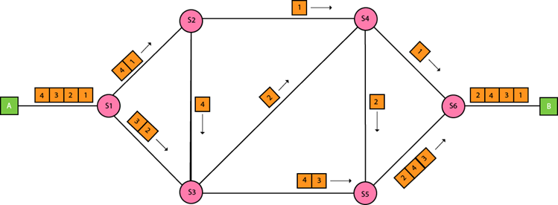
Fig of packet switching

Slide 84
Difference between synchronous communication and asynchronous communication
Basis for Comparison | Synchronous Transmission | Asynchronous Transmission
Meaning | It is the characteristic of a communication system in which the sender must coordinate(i.e. synchronize) with the receiver before sending data. It Sends data in the form of blocks or frames | It is the characteristic of a communication system in which the sender and receiver do not coordinate before the transmission of data. It Sends 1 byte or character at a time
Transmission Speed | Fast | Slow
Cost | Expensive | Economical
Time Interval | Constant | Random
Gap between the data | Absent | Present
Examples | Chat Rooms, Video Conferencing etc | emails, forums, etc

